Slide 1
Culture of Guangdong, china
Presented By:
Helen Zhou

Slide 2
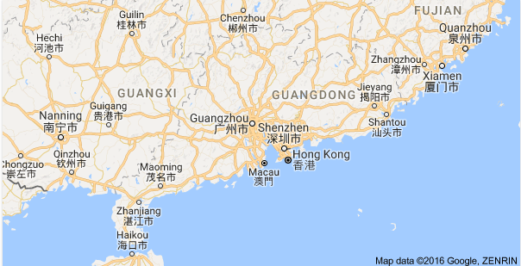
Location of Guangdong, China
Situated in the southernmost part of China's mainland, it covers a land area of 179,800 square kilometers, an island area of about 1,592 square kilometers and has 3,368 kilometers of winding coastline, which is the longest in the country. Rivers from all over the province discharge into the South China Sea, forming the fertile Pearl River Delta, which is one of the countries' most densely cultivated areas. Its capital city, Guangzhou, formerly known as Canton to the western world, is located in the north of this river delta.

Slide 3
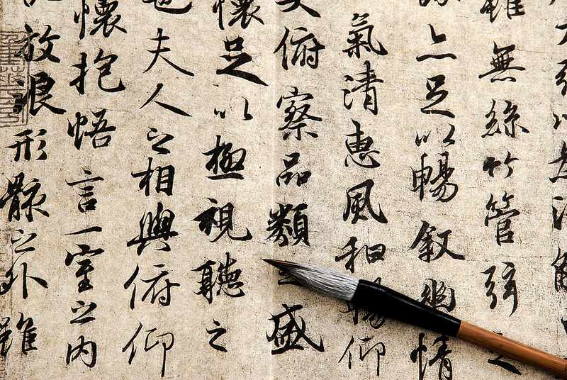
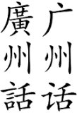
Language of Guangdong, China
Cantonese is also known as Standard Cantonese is the dialect of Yue Chinese spoken in the vicinity of Guangdong in Southern China.
Cantonese is the language of the Cantonese people. In mainland China, it is a common language of Guangdong Province and some neighboring areas, such as Eastern
Guangxi Province.

Slide 4
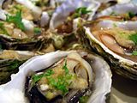
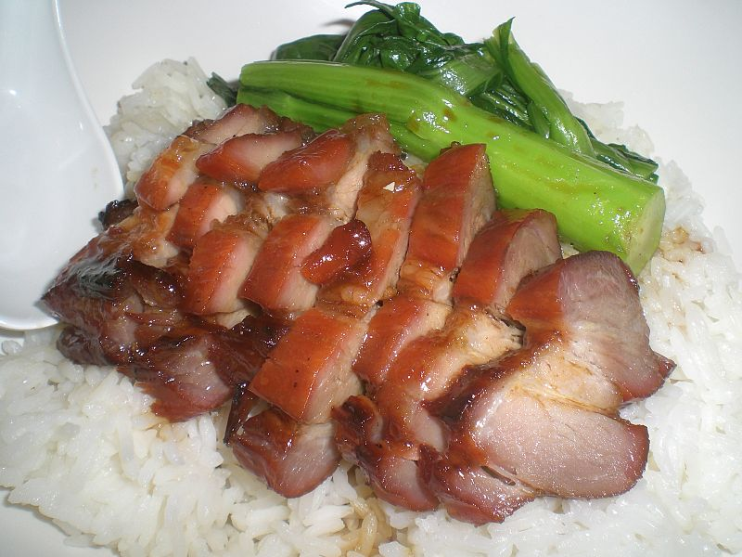
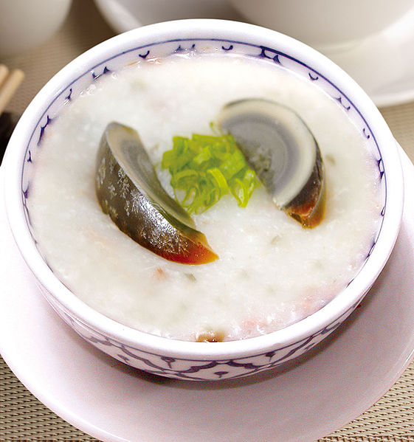
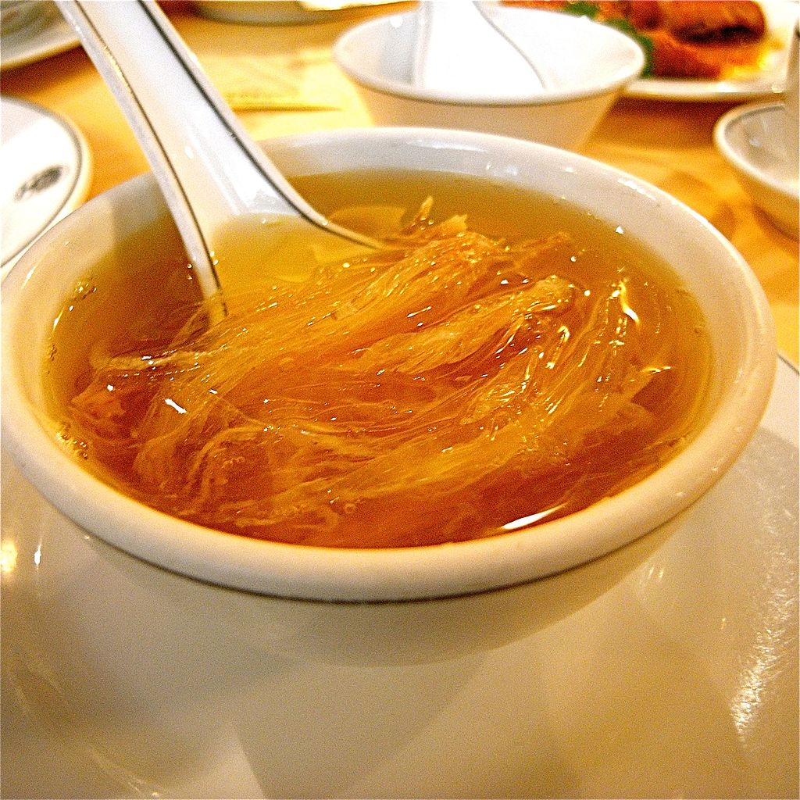
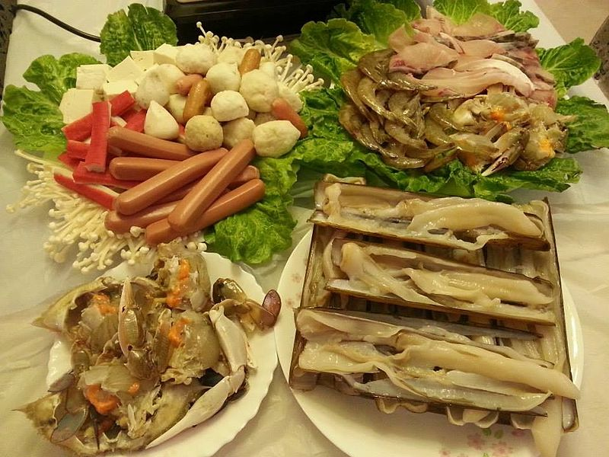
Food of Guangdong
Cantonese cuisine and is one of the Eight Culinary Traditions of Chinese Cuisine.
For many traditional Cantonese cooks, the flavors of a finished dish should be well balanced and not greasy. Apart from that, spices should be used in modest amounts to avoid overwhelming the flavors of the primary ingredients, and these ingredients in turn should be at the peak of their freshness and quality.
In Cantonese cuisine, a number of ingredients such as spring onion, sugar, salt, soy sauce, rice wine, corn starch, vinegar, scallion oil, and sesame oil, suffice to enhance flavor, although garlic is heavily used in some dishes, especially those in which internal organs, such as entrails, may emit unpleasant odors. Ginger, chili peppers, five- spice powder, powdered black pepper, star anise and a few other spices are also used, but often sparingly.

